Slide 1
VCS and Git
(Version Control System)
It’s have the concept about version control system and distributed version control system git

Slide 2
Contents
What Is A Version Control System (VCS)
Types of VCS
Top 5 Free VCS
What Is Git
How Do We Get Started With Git And Github…
Basic Help & Init Commands
Basic Workflow Commands
What Is Github or Gitlab
Advance Workflow Commands

Slide 3
What Is A Version Control System
The version control system as name suggested, is a systems that used in software development and collaborative project to track and records all changes in source code, document, files or set of data. Whether we are working alone or in teams, version control system (vcs) make ensure your work is safe, organized and all the team members are working on latest version file’s. And there everyone can work simultaneously on the same project.
Note : In VCS, if something breaks or doesn’t work, the team can compare versions, isolate the issue, and restore stable code without starting from scratch.
There are three types of version control system;
1. Local Version Control System 2. Centralized Version Control System 3. Distributed Version Control System

Slide 4
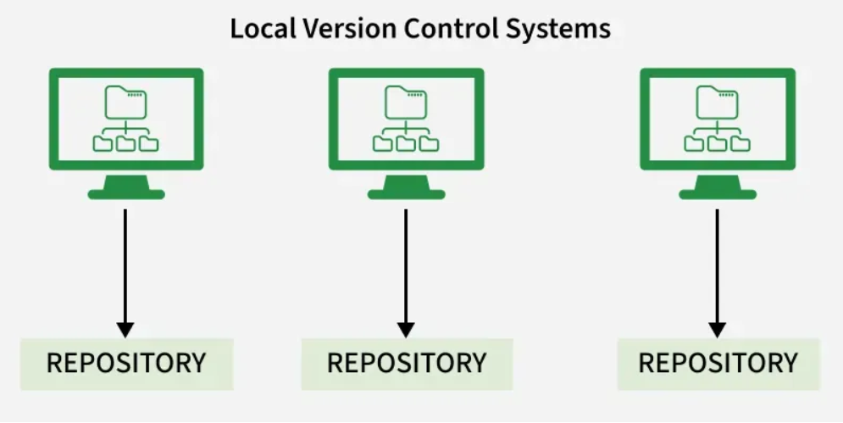
Types of Version Control System
Local Version Control System : A Local Version Control System entirely operate on our local machine without any connection of remote repository. All the change and version history are store in local database on our computer. In this system, there can no collaboration and sharing of changes occurs with other users.
Centralized Version Control System : A Centralized Version Control System operate as the main source server for the entire project with the connection of remote repository. So all changes and version history are stored in single (main) central server.

Slide 5
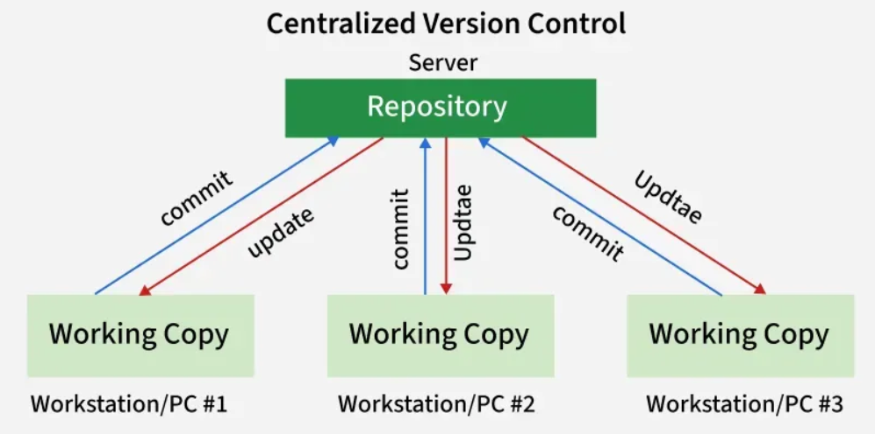
And there each developer can connect to this server to access and modify files but they do not maintain a full local copy of the project. Whenever a developer wants to make changes, they check out the files from server. Once the work done, they commit their changes back to the repository and other developer can update their local version to see the changes. Some of e.g of centralized system like : Subversion, CVS
Note : The most obvious drawback is single point of failure represented by the centralized repository. If the repository goes down, we would not be able to collaborate or save there changes.

Slide 6
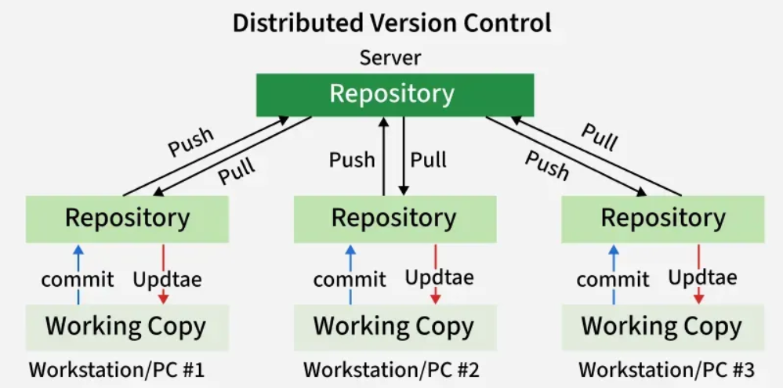
Distributed Version Control System : A Distributed Version Control System operate as the snapshot of main source server for entire project with connection of remote repository. So the each user contains their own local repository (snapshot) and working copy/working directory. and all the changes, version history stored on own local repository (snapshot). In this system, any commit will not give access directly to other user because all commit will reflect those changes on our local repository. we need to push them in order to make them visible on remote repository and similarly we do not get updated those changes unless we have first pulled those changes from remote repository into local repository. Some of e.g of distributed system like : Git, Mercurial.

Slide 7
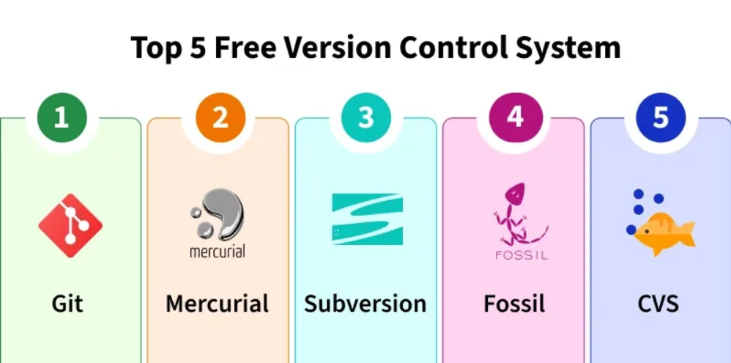
Top 5 free version control system
There are many widely used free VSC tools which is perfect for individual and teams. But we can use any version control system based on project size and team collaboration.
For More : https://www.geeksforgeeks.org/git/version-control-systems/

Slide 8
What Is Git
Git is the most popular and widely used free, open source distributed version control system developed by Linus Torvalds in 2005 for managing the Linux kernel.
Git is used coordinate the workflow among the project team members and track changes in project files progress over time which can handle any size of project. And it also benefits both for programmers and non-technical users by keeping track of their project files and allow multiple users to work together without any interruption each other’s work. Why should be use Git because : It’s Free, Open source, Fast, Scalable and Provide Operation like Branching/Merging.
Git is backbone of the service like GitHub, GitLab and Bitbucket, making it a popular choice for developers worldwide.
Note : In the following slide, discuss about the git and git command for operate the project files through Service Github or GitLab.

Slide 9
Key Takeaways On Git :
Git is Free, Open source, Fast, Scalable and Distributed version control system. Which has a distributed architecture
It provide a flexible environment to work collaboratively and securely. And it can be used to update, record, revert, compare files changes and create, manage remote repository using Git.
Git facilitates the branching and merging of files within the main repository.
Git allow every user to have a copy of project files locally, thus making the files in the server secure.
There are three level of configuration in Git: System Level, Global Level, Local Level.
User setting in Git are mainly defined at Global Level because they correspond to user level setting for all repository.

Slide 10
How do we get started with Github and Git
It is easy to get things going with github and for starting, click on the Github Site and create the account. Then we will consider on downloading Git on our system ; For Window : https://git-scm.com/downloads/win Linux : use command - `sudo apt-get install git` | (link) Mac : use command - `brew install git` | (link)
Then will go on our system terminal ( for window use git base, and for linux/mac use default terminal ) and make our self known to Git by run the basic settings for every repository. Some Basic Setting For Configuring Git :
Name
Email
Default Editor
Line Ending
And we can specify this configuration setting at three different level ;
System Level : setting here is applied for all users on current computer / system.
Global Level : setting here is applied for all repositories of current user.
Local Level : setting here is applied for current repository in current folder.

Slide 11
Configuring Git Setting Commands : In this configuration, we will use global level setting commands.
Name Command - git config --global user.name “John Deo”
Email Command - git config --global user.email john.deo@gmail.com
Default Editor Command - git config --global core.editor “code --wait” # as default editor we want to use vscode, so we will set vscode using core.editor - code - git config --global -e # this command open the default editor to edit all the global settings
Line Ending Command - git config --global core.autocrlf input/true
# so on Windows end of lines are marked with two special characters carriage return (\n) and line feed (\n) and linux/mac end of lines are indicated with line feed, so if we don’t handle the end of line properly then we’re going to run some weird issues. To prevent this, we have to configure a property core.autocrlf which is the short for carriage return line feed. So if there we use window then use ‘true’ or if use linux/mac use ‘input’ as command.
Note : For list about all git configurations, use the following command; - git config --list

Slide 12
Basic --help and init Commands
Now here we will discuss some others basic command. Than will go through mostly uses git commands.
help Command - This command use to help with more details description about some specific part like : config, push, pull, shash, add, commit etc. using following command; $ git config --help / git pull -h ( for short summary) $ git add --help $ git commit --help $ git push --help $ git pull --help $ git stash --help
init and clone Command - Starting of project first time, We are required to add the project directory / working directory and git repository by using init command ( which used to create the empty git repository on local machine ) or Can take the snapshot as git remote repository from remote system ( like Github ) to local machine by clone command. So this empty or clone repository are useful for apply / commit changes from working directory to local git repository. That further could be push on remote repo.

Slide 13
$ mkdir <dir_name> e.g : dir_name - Moon $ cd <dir_name> $ git init # initialized empty git repository in <project_dir_path/.git/> Or $ git clone <repository_url> # repository_url like : https://github.com/octocat/Spoon-Knife.git
Note : here git repository may contains history about branches, config, HEAD, hooks, info, object and reference. And by default branches point out the head as master or main branch.

Slide 14
Basic Workflow Commands
These git commands have used as daily bases.
status Command - Show the status of working directory and stating area/index
$ git status # show long descriptive status of files and folders… $ git status -s # show short status of files and folders…
fetch Command - This command downloads all branches and their respective commits from the remote repository to your local repository. $ git fetch # if only one remote origin, use this for fetch repo… $ git fetch - -all # if multiple remote origin, use this for fetch all repos…
branch Command - This command use to list all the created local and remote branches $ git branch # show the working branches… $ git branch -a # show the all working as well as remote branches…

Slide 15
checkout -b / branch Command - It is used for create the new branch into git repository and switch on new branch.
$ git branch <new_branch_name> # use to create new local branch… Or $ git checkout -b <new_branch_name> # use to create new local branch… For switch on to the new branches, use the following commands;
$ git switch <another_or_new_branch_name> Or $ git checkout <another_or_branch_name>
Note : We will see more details about git branching / git branch in advances workflow commands section…

Slide 16
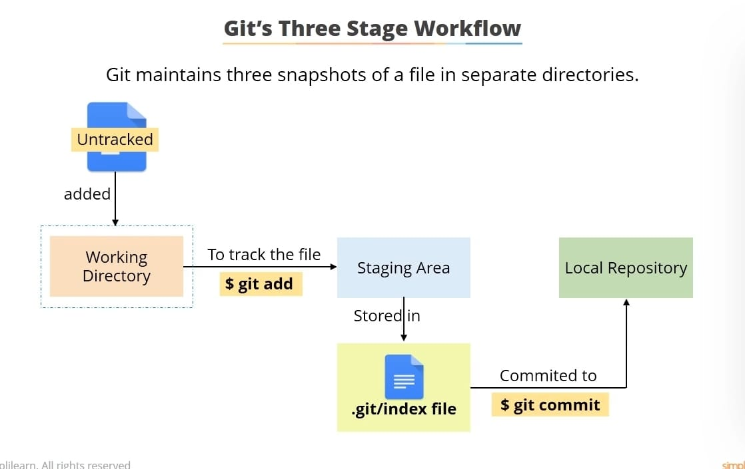
Known About Three Stage WorkFlow -

Slide 17
add Command - Use to add new files or modified files from working directory to staging area/index area. $ git add <file_name> # file name may be anything… $ git add file1.txt | $ git add file2.txt $ git add file1.txt file2.txt file3.txt … $ git add *.txt # all file add that have extension .txt or any… $ git add . # use period to add entire repo files…
commit Command - This command used to taking snapshot of changes in the staging area/index and store permanently into local git repository. Commit are combination of (unique id, name, date and message)
$ git commit -m ”Initial commit” # commit with one liner message… $ git commit # commit with one liner message not enough then this command open the default editor where we can give long description with short message… $ git commit -am ”New commit” # it is use skip the ‘git add .’ command and directly made commit with (-a and -m) or (-am) options instead adding changes from working to staging area But this is used when we know that what exact changes made on file or folder.

Slide 18
rm Command - This command used to remove unused code file. There is two way ; Way 1 - By using standard unix/linux rm command :
$ rm file1.txt # remove files using standard unix rm command… and directory will be dirty because files remove only from working directory not from staging area. So for check the remove file exist on staging area by using “git ls-files --stage“ command then do the further process again like “git add <file_name>” and “git commit -m <message>” for applies completely remove files changes in staging as well as final commit of local repo… $ git add <files_name> $ git commit -m ”remove files commit”
Way 2 - By using git rm command : $ git rm file1.txt # remove files using git rm command… and in that case, directory not dirty because files remove from both working directory as well as staging area. So here we don’t need to run again add command instead directly use “git commit -m <message>” to applies remove file changes commit in local repo… $ git commit -m ”remove files commit”
Note : Use command for only remove files from staging area - $ git rm --cached <files_name>
Note : For recovering the remove files from previous commit using - $ git checkout <commit_id/HEAD~1> <file_name>

Slide 19
mv Command - This command used to renaming or moving files. There is two way ; Way 1 - By using standard unix/linux rm command :
$ mv file1.txt main.js # renaming files using standard unix mv command… and directory will be dirty because files rename or move only from working directory not form staging area. So similar to remove the files, there are need two step process. One for adding deletion of old file and another is adding of new file changes in staging. And for further process again use like “git add <file_name>” and “git commit -m <message>” for applies completely renaming files changes in staging as well as final commit of local repo… $ git add file1.txt # one use for add delete old name file change in staging… $ git add main.js # another use for add rename new file change in staging… $ git commit -m ”rename or moving files commit”
Way 2 - By using git mv command : $ git mv file1.txt main.js # similar to remove, this command rename or move the file from both working directory as well as staging area. So here we don’t need to run again add command instead directly use “git commit -m <message>” to applies rename file changes commit in local repo… $ git commit -m ”rename or moving files commit”

Slide 20
.gitignore file Command - In every project, we should tell to git for ignoring certain files and directory for e.g - log or binary files which can increase the size of repository without providing any value. So This is happening by using .gitignore file ;
E.g - $ mkdir logs # So let suppos, we has created a dev.log file into logs directory. $ echo “hello” > logs/dev.log # Add string hello into dev
Note : Now this logs file directory will display on working directory / unstaging area on ‘git status’. So for ignoring this types of file, we need to create a special file .gitignore on root project dir. and mansion all those file/folder name ( logs/ or dev.log or *.log ) inside .gitignore file that we want to ignore. Then these files won’t be show in working directory for adding in staging area. Now finally .gitignore file will show in working directory, which is require to add and commit in staging and git repo. $ git add .gitignore $ git commit -m ”Add file gitignore”
For more about .gitignore file templates for different languages, please follow link

Slide 21
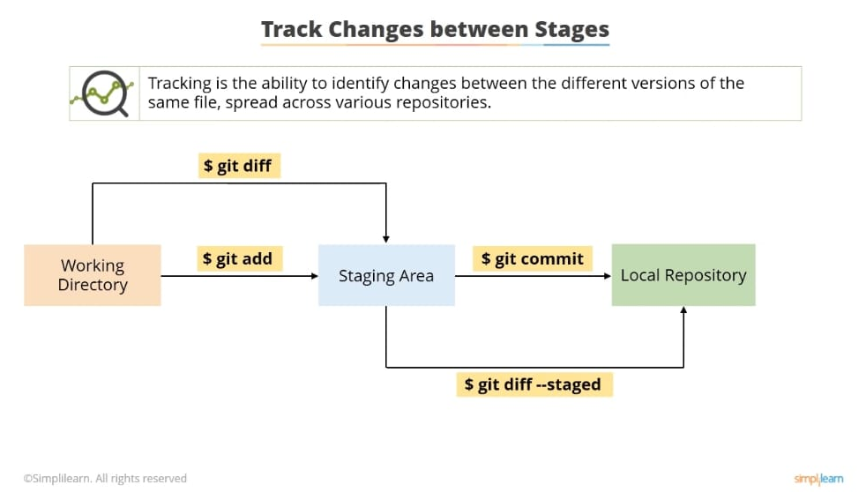
Known About Track The Changes Between Stages :
1.

Slide 22
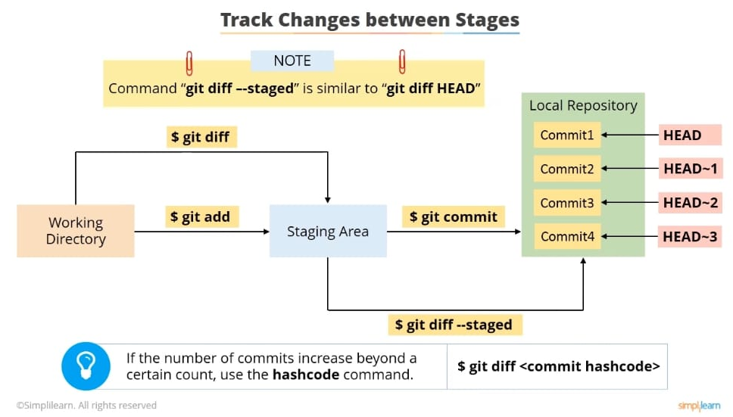
2.

Slide 23
diff Command - Sometime, we have made some couple of changes in working directory/unstaging area and staging area/index. And sometime we need to compare or review these changes into files before commit in git repository, so we can use diff command here ;
E.g - $ git diff Or $ git diff <file_name> # compare and show all changes for new copy ( current working directory changes ) with old copy ( last staging changes ) into working directory / unstaging area…. $ git diff --staged <file_name> # compare and show all changes for new copy ( current staging changes ) with old copy ( last commit changes ) into index / staging area… Note : recall, if we run ‘git diff’ without any arguments then we can see all unstage / working directory changes. And if we run ‘git diff’ with --stages arguments then we can see all staging / index changes.

Slide 24
log Command - It is use for looking the history of commits which is sorted from latest to earliest ;
E.g - $ git log # can see the history of commit in more descriptive way Or $ git log --oneline # display the history of commits in short summary way…. $ git log --oneline --reverse # reverse the history of commits in earliest to latest order…
Note : if we want to see the specific commit changes then can use the following different command : $ git show <commit_id> # show the changes with specific commit id…
$ git show HEAD # show the changes of the HEAD or latest commit…
$ git show HEAD~ # show the changes of previous commit before HEAD commit… $ git show HEAD~1 # show the changes of previous commit or commit which is 1 step back before HEAD commit… Similarly we can see any previous commit by passing step number after HEAD~ like : HEAD~3, HEAD~5, HEAD~2 and so on.. $ git ls-tree <commit_id> # show the all files and directory of a commit in hierarchical way… And this represent Commit, Blobs (files), Tree (directories) and Tags.

Slide 25
checkout / restore Command - These command used for restoring or undoing changes from working directory or staging area.
$ git checkout <file_name> | git checkout $ git restore . # undo the change in specific file or entire files in from working directory… Or $ git restore --staged <file_name> $ git restore --staged <file_name1> <file_name2> $ git restore --staged <*.<extension>> # use any extension like .txt / .js / .py etc. $ git restore --staged . # undo all changes in specific file or entire files from staging area… and move change from staging to un-staging area / working directory
Note : Just if we want to discard all the change from working directory or staging area. Then we can use the follow command. But make sure it can risty because it will clean entire changes on local working dir. $ git clean -fd # use for clean all changes from file and directories forcefully with option -fd

Slide 26
checkout / reset Command - These command used for restoring changes from earlier version ( undoing commit from local git repository to staging area or unstaging area ).
Note : Some time files have deleted from working directory that was committed with latest version. But whenever we are willing to restore these files, then can use the earliest/previous commit for undoing changes in directory.
$ git checkout <previous_commit_id> <file_name> | $ git checkout HEAD~1 <file_name> Or $ git restore <previous_commit_id> <file_name> | $ git restore --source=HEAD~1 <file_name> # restore the specific files from previous commit into working directory…
Otherwise we should use following command; $ git reset --hard <previous_commit_id> | git reset --hard HEAD~1 # restore the all changes files and directory from previous commit into working directory… Or $ git reset --soft <previous_commit_id> | git reset --soft HEAD~1 # restore the all changes files and directory from previous commit into staging area…

Slide 27
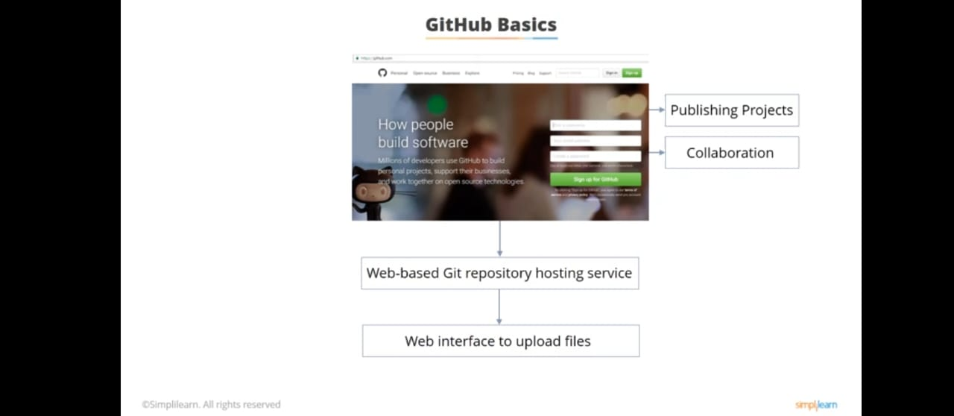
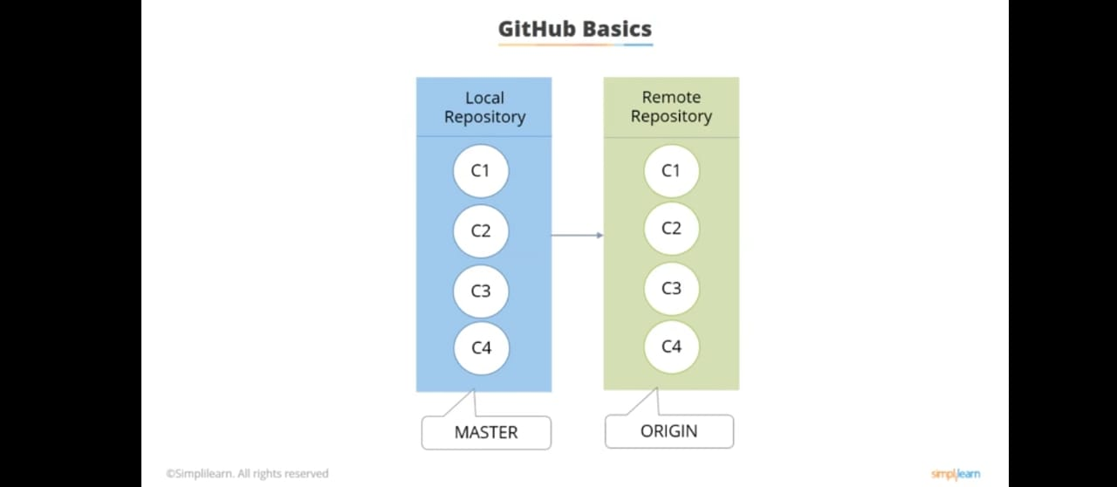
What Is Github or GitLab
Github is popular programming resource that used as git repository hosting and code sharing. It’s provide the web user interface for manage the projects. It is the world largest community, which allows collaboration with developer from all over the world. And enable potential developers to contribute and share their knowledge to benefit the global community.
Github have some feature like :
Easy project management
Effective Team Management
Improve Code Writing
Increased Code Safety
Easy Code Hosting

Slide 28
KeyPoint About The Github :
Github is popular web-based git repository hosting service that provide web interface for the users to upload the files from their local repositories.
We can create a repository in Github using two protocols, that is HTTPS and SSH.
Git pull and Git push are the two commands in git, used to collaborate between the local and remote repositories.
In Github, “Issues” acts as a place where you can raise Bugs and track them.

Slide 29
push Command - These command used for push the changes from local repository to remote repository ( on github repository ).
$ git push origin master/main # push the changes from local to remote repository…
So there are two ways for setup the empty remote repository on github and push the each local repo changes commit on the remote repo using HTTPS or SSH.
In HTTPS, We are required to give the username and password to make every push of changes.
While In SSH, We generate the ssh key (using ssh-keygen) and add this key inside github setting to make every push of changes without username or password. So in this case github always verified the user by added public key.

Slide 30
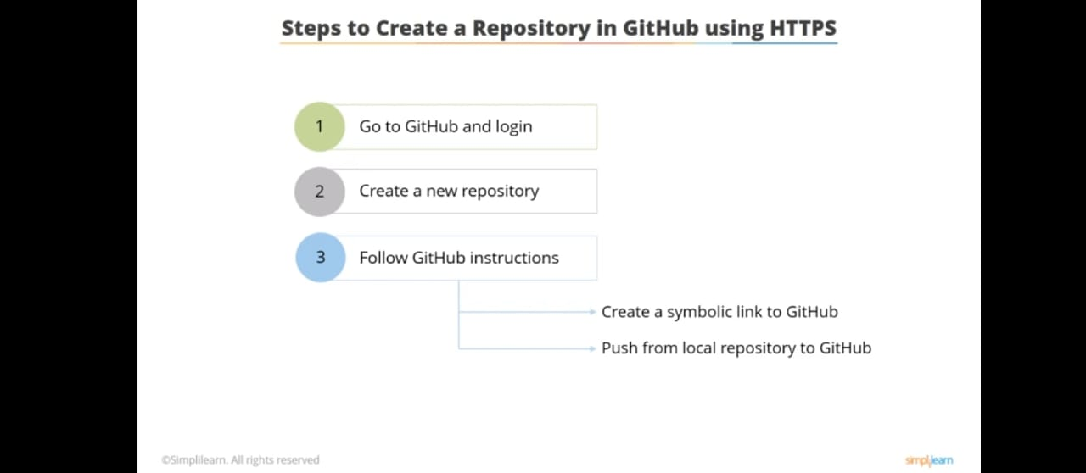
Way 1 : 1. In this way, some steps will show to create a repository in github using https and push the changes on remote repo…

Slide 31
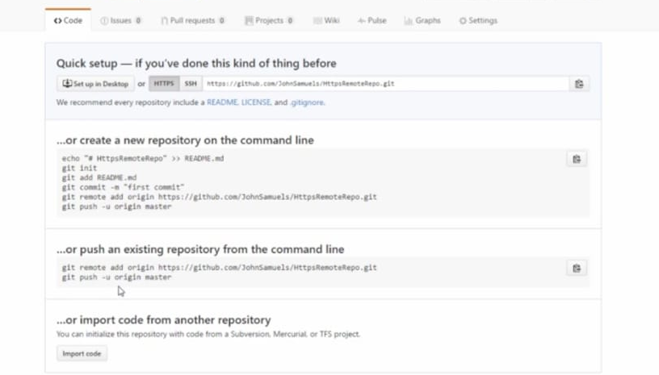
2. This is all quick setup command, which have shown when new repo create on github.

Slide 32
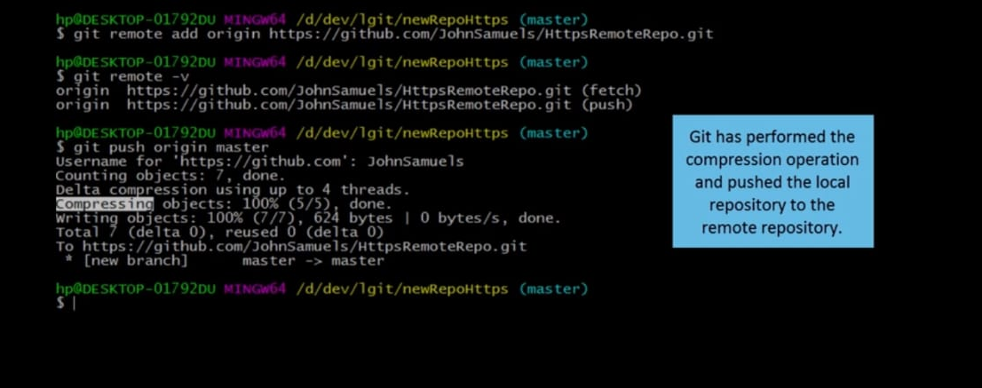
3. There is some command which display push the changes.
But remember after creating the repo ( if repo is newly created on github ) and before push the changes on github, we must be added the remote repo as origin using the following command; $ git remote add origin <https_repository_path> # repo_path : https://github.com/username/repo_name.git

Slide 33
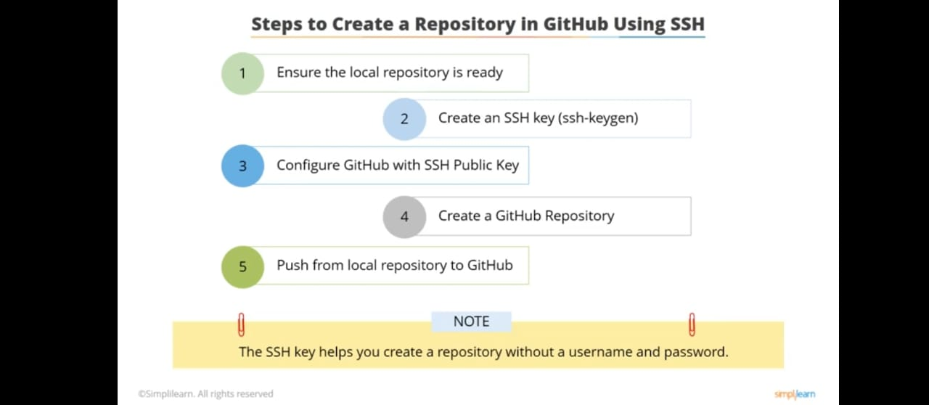
Way 2 : 1. In this way, some steps will show to create a repository in github using ssh and push the changes on remote repo…

Slide 34
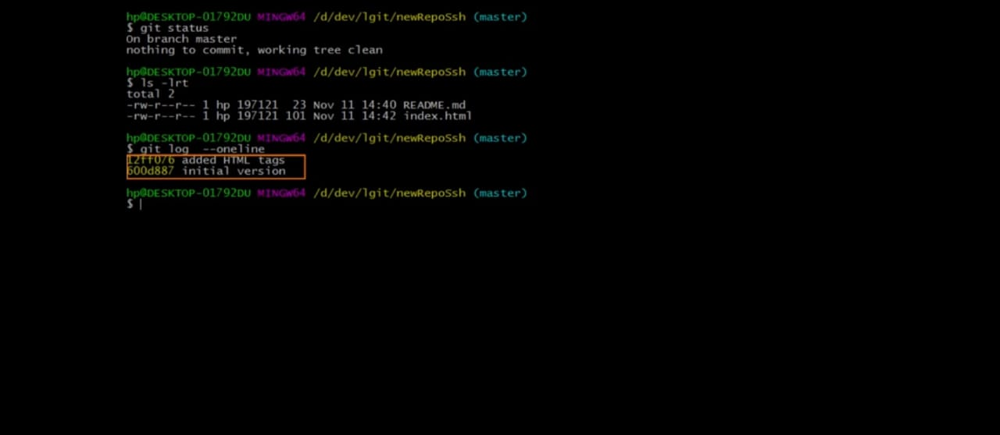
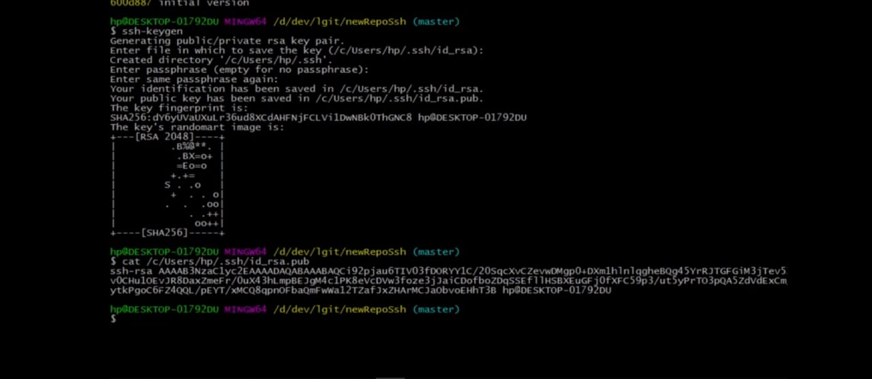
2. These all command used for ensure local git repo with ready some commit. Then generate the public key for configuring the Github repository using ‘ssh keygen’.
1
2

Slide 35
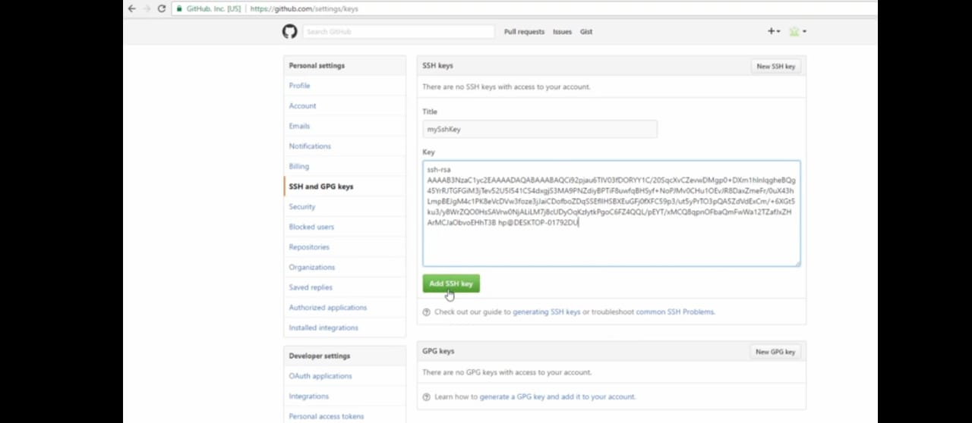
3. There step add the public key at the path github->profile->settings->ssh_and_GPG_keys for configuring the Github repo.

Slide 36
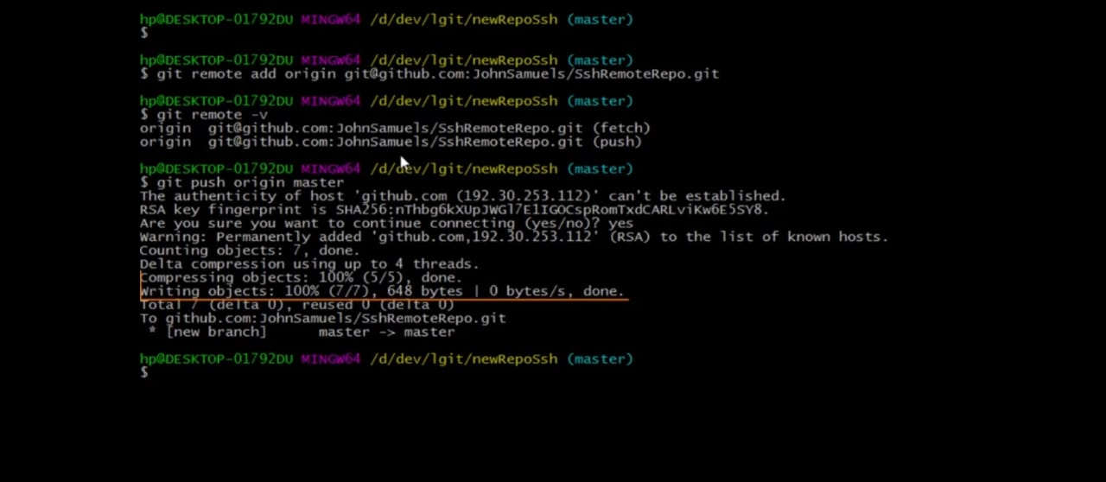
4. There is some command which display push the changes.
But remember after creating the repo ( if repo is newly created on github ) and before push the changes on github, we must be added the remote repo as origin using the following command; $ git remote add origin <ssh_repository_path> # repo_path : git@github.com:username/repo_name.git

Slide 37
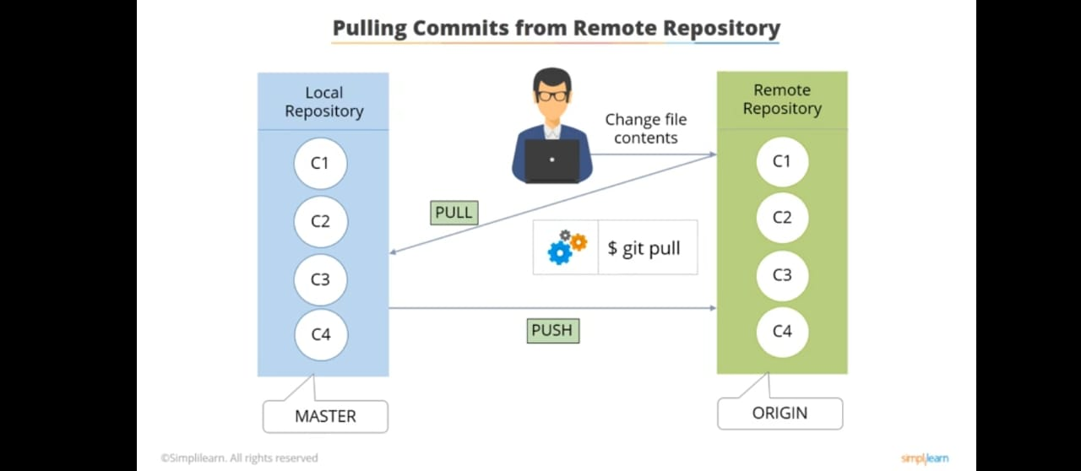
pull Command - These command used for pull commit from remote repo to local repository, So basically it is fetch the change commit and merge into working directory.
$ git pull origin master/main # fetch the changes from remote repository to local…
# when someone made the changes and commit these into same remote repository in which we are still working. So in this case, we needs first pulling for change into our local rapo, Before made the push any changes commit from our side.

Slide 38
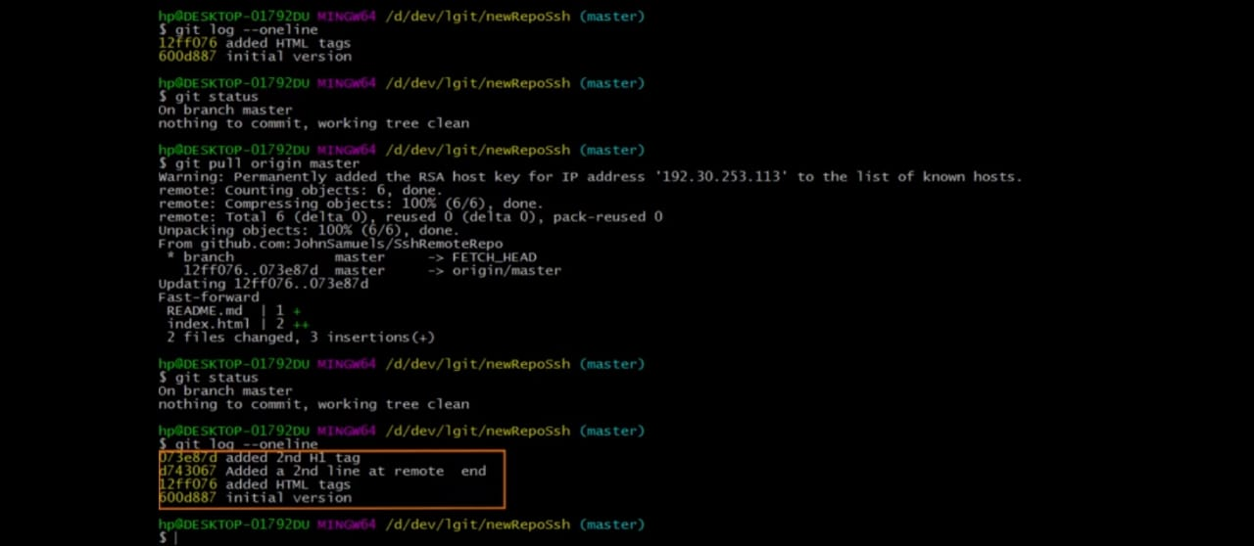
There are demo that display the process for taking the pull all changes commit from remote to local.

Slide 39
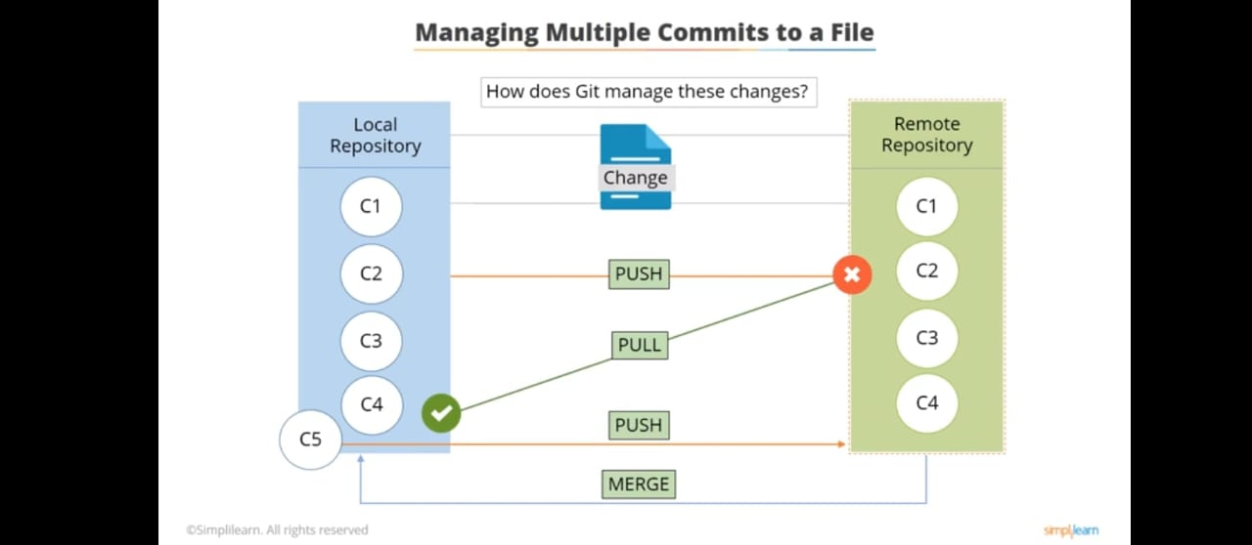
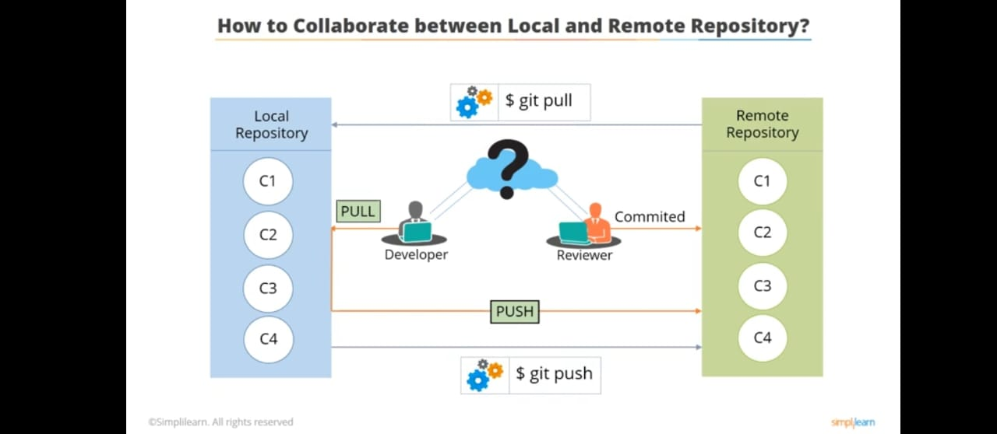
Different Scenarios For Push and Pull Operations :
In first scenario, show the collaboration of team member between local and remote repository for managing multiple commit when they work on same project, same files but creating or modifying different lines on code. So here someone developer made any change to a file, reviewer reviews and commit it on remote repository. but others developer who are working on same project repo with same file will need to pull all commits ( means fetch remote repo commit and merge into local repo ) before push any changes ( because any push before the pull will throw error if any changes available on remote repo ) then reviewer again review and commit it.

Slide 40
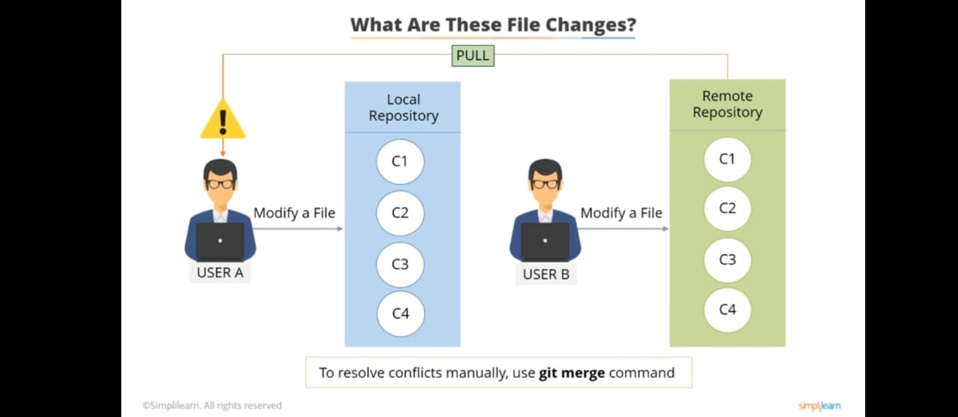
In second scenario, also show the managing multiple commit when developers work on same project, same files but creating or modifying same lines on code. In that case, User B have already modify the file and made push, commit the changes on remote repo. Then User A who has also create or modify same line of code on local repo. So when he will take the pull all changes commit from remote before push then some conflict could occurs on local ( means same code can show two time inside same file ). To resolve these conflict, user need to manually remove some line of code from file and need to add ( git add . ), commit ( git commit -m “message” ) it again.
# its process of collaborate by team member on git who are worked on same project and follow this git cycle.

Slide 41
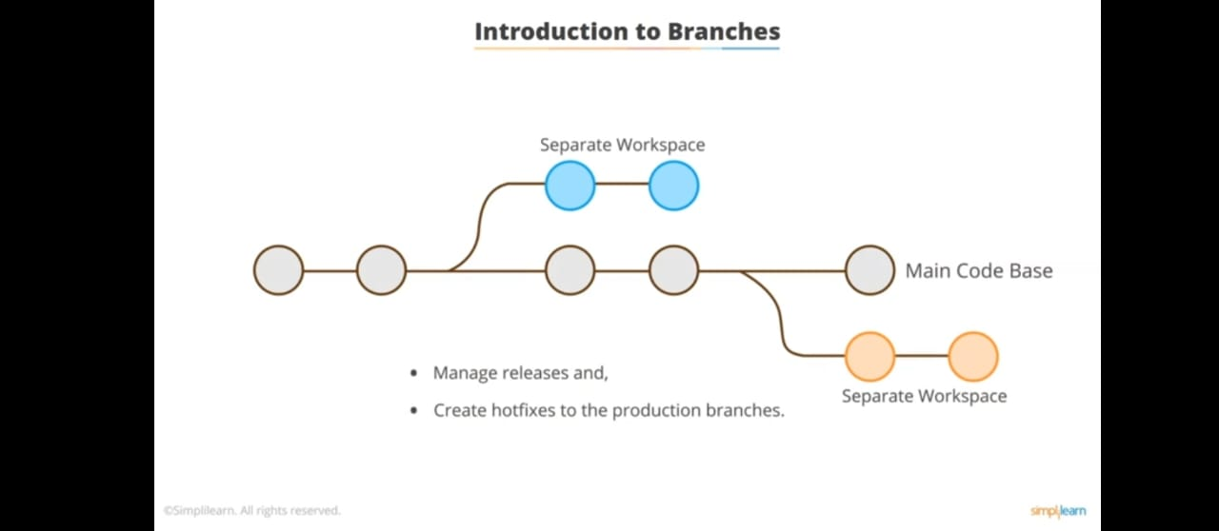
Advance Workflow Commands
Known About The Git Branching : Git branching are like a tree which contain different line of code in separate workspace ( specifying by pointer to the commit ) without affecting the main code branch.
These are use for managing releases and creating hotfixes ( Involve rapid development, Isolated software patch to resolve critical bugs or security vulnerability in live system ) to the production branches.

Slide 42
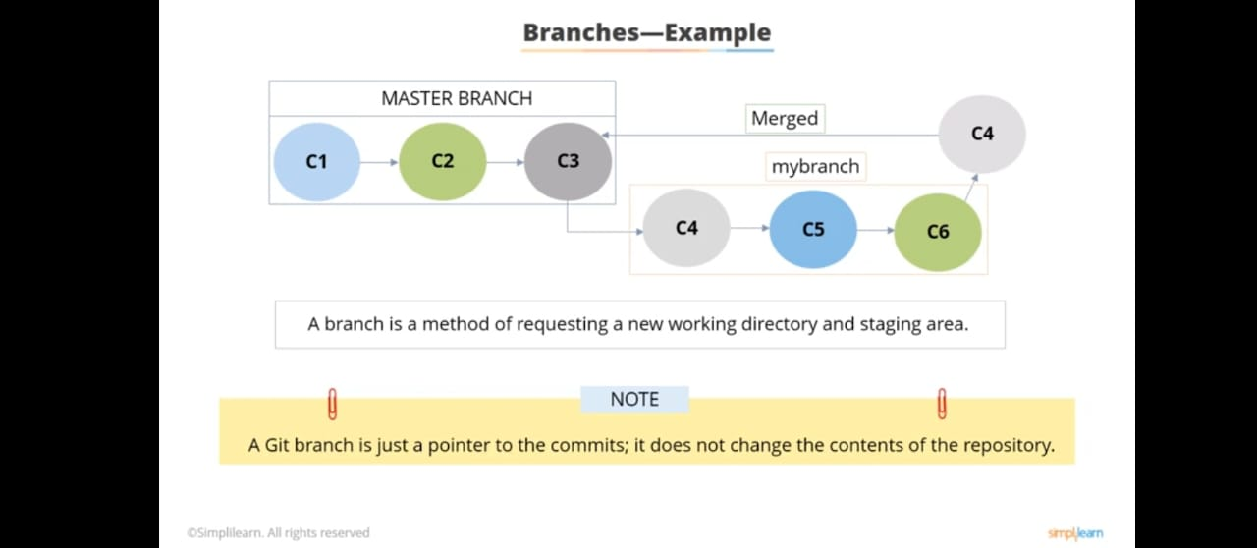
Example Of Git Branching :
Assume that we have a master branch with some commits, So here we can create new branch like `mybrach` as separate code workspace which would have the snapshot of the main / master branch including files and changes commit. This new branch also refer the new working directory and staging area where we can made any changes and commit and further we can merge with main code bash.

Slide 43
branch Commands - There are some branch command which could be used for creating, switching or listing branch.
$ git branch <branch_name> # Create a new branch…
$ git branch # List all branches in the current repository…
$ git checkout <branch_name> # Switch to branches…
$ git merge <branch_name> # Merges the branches…
Note : To create a new branch and also switch to it, then we should execute following command…
$ git checkout -b <branch_name> # Create a branch and switch on it with snapshot of existing branch…

Slide 44
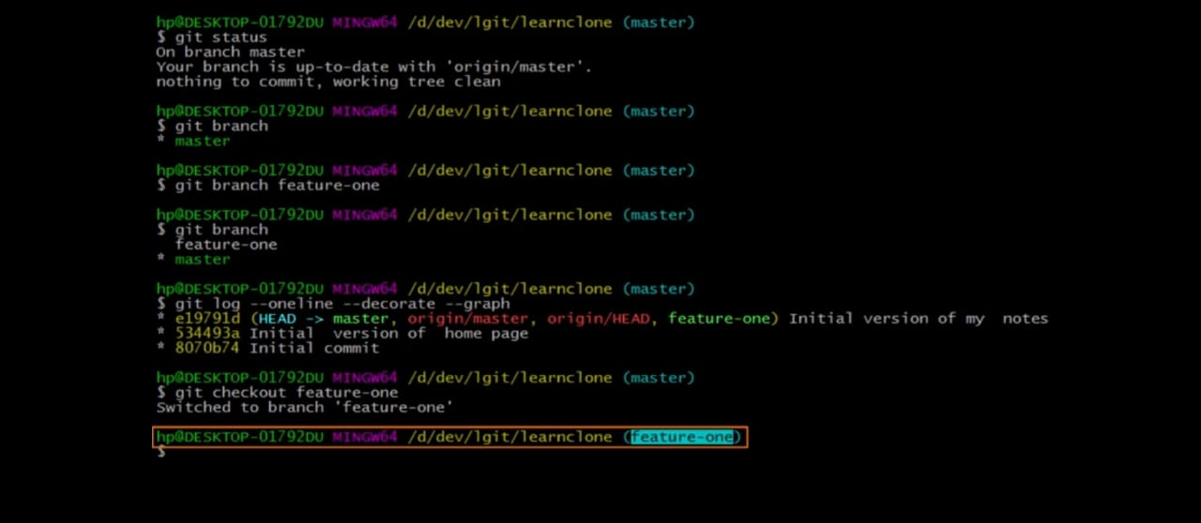
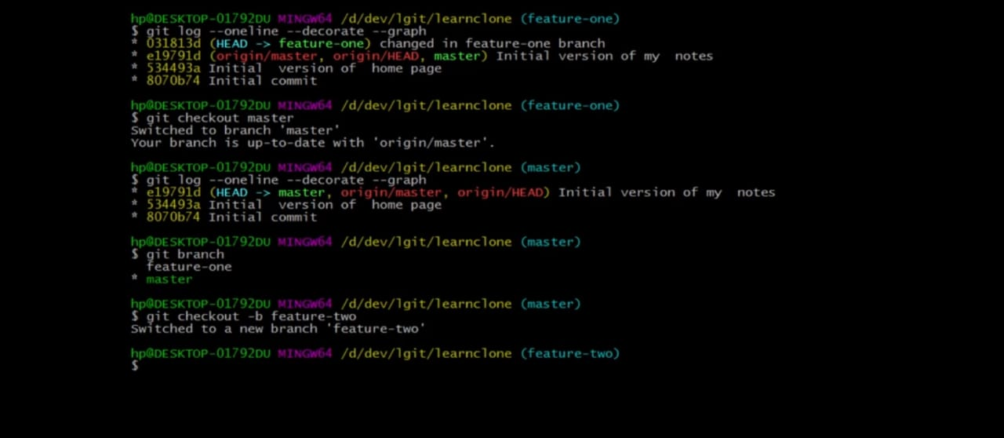
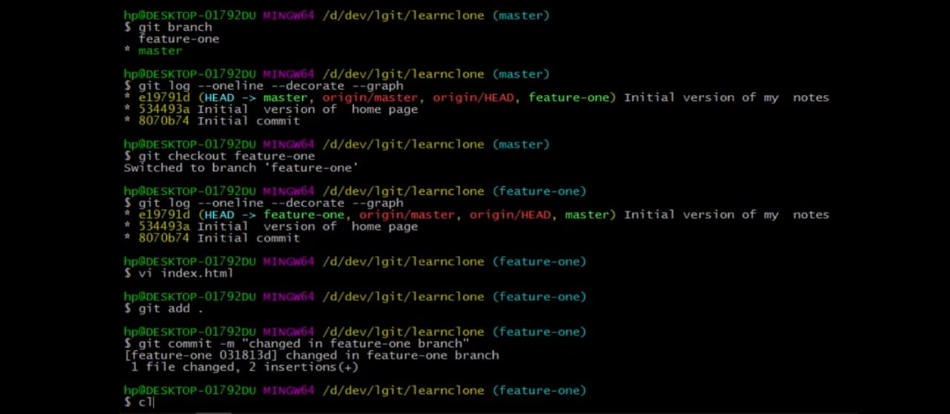
Demo : It’s display the about creation of a branch , switching on branch and listing of branches…
1
3
2

Slide 45
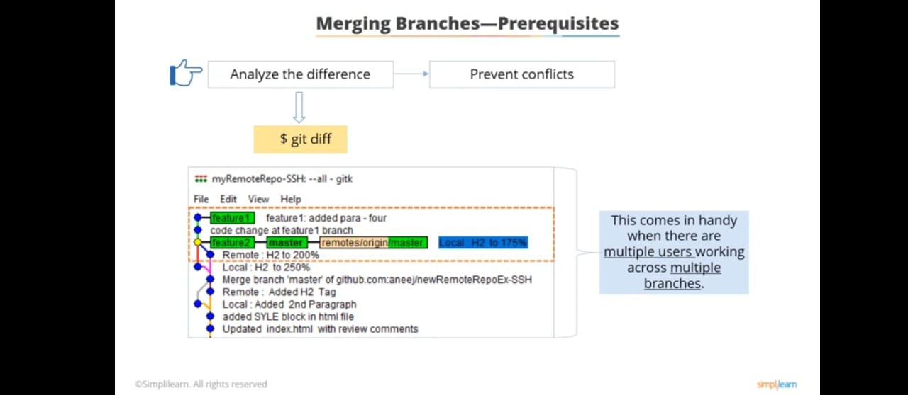
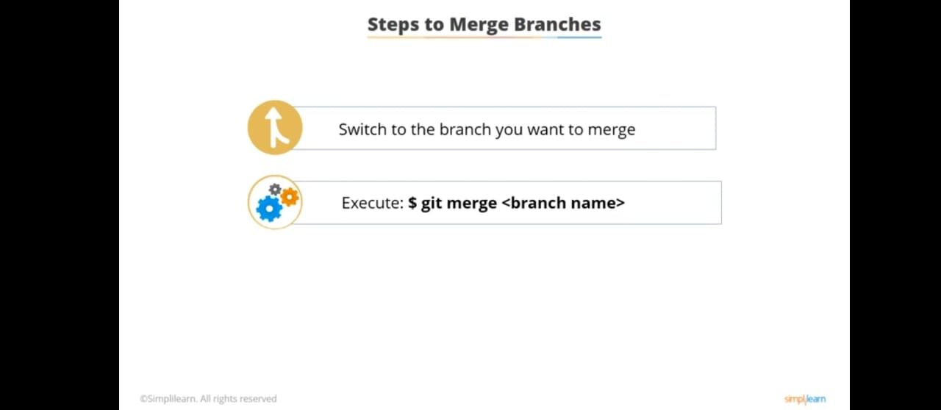
Known About The Git Merging : Git merging is use for integrate the change from one Git branch to another which combines two or more sequence commits changes and merge into target branch by creating single commit. So `git merge` command provide the facility to bring all those changes from source to target branch.
But before the merging, we should analyse the difference Between two branches using `git diff` command or using Gui ( graphical user interface ) tool.
merge Commands - git merging follow some steps for merge the branch; 1. First switch on the target branch where we want to merge into.
2. Execute the git merge command follow by source branch name from where brings the changes.
$ git merge <source_branch_name>

Slide 46
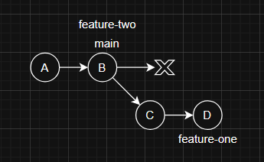
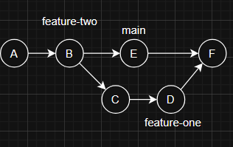
Types Of Merging : There are two methods for merging the branch;
Fast Forward Merge
Recursive Merge
Note : Git merge algorithm use fast forward method, if latest commit of the target branch / main branch where we are merging into is the same parent commit of source branch / feature branch which we are merging from.
E.g - Let check in the first diagram, where target / main branch have two commit A, B. And B is the latest commit for main branch which is parent commit for new branch feature-one that follow two commit C, D. So In this case, main branch pointer will move on feature-one commit, And there no new commit will create.
But Git merge algorithm use recursive merge method, if latest commit of the target branch is not same parent commit of source branch. E.g -
Let check in the second diagram, where target/main branch have three commit A, B, E. And E is the latest commit for main branch which is not parent commit for feature branch. feature-one have parent commit B. So In recursive meage, all feature-one commits will combine and merge into target branch with new commit F.
And In both of the methods, merging can be applied in two way without conflict and with conflict. So prevent these conflict we should follow git diff command or gui (graphical user interface) tool.

Slide 47
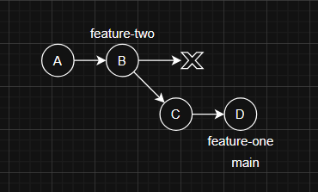
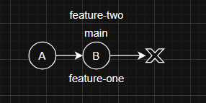
Fast Forward Merge : In this method, the branch ( like target branch / master or main branch ) into we are merging has simply moved ahead of the branch ( like source branch / any feature branch ) from where we are merging. Here git perform “fast-forward merge” by default so in this case, No new commit is create on target branch for merging the source branch.
e.g - here we have main branch and create two more branch feature-one, feature-two in first diagram. some new commit change are in feature-one in second diagram, main and feature-two are on same commit. So when feature-one is merge into the main branch then main branch pointer will move ahead of feature-one branch without creating new commit.

Slide 48
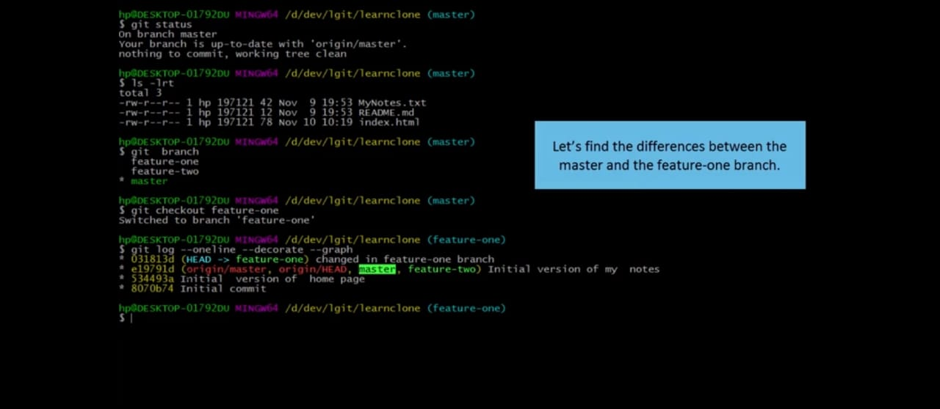
Demo 1 : In this demo, display creating of new feature-one branch and merge into main without any raised conflict.
1
3
3
2

Slide 49
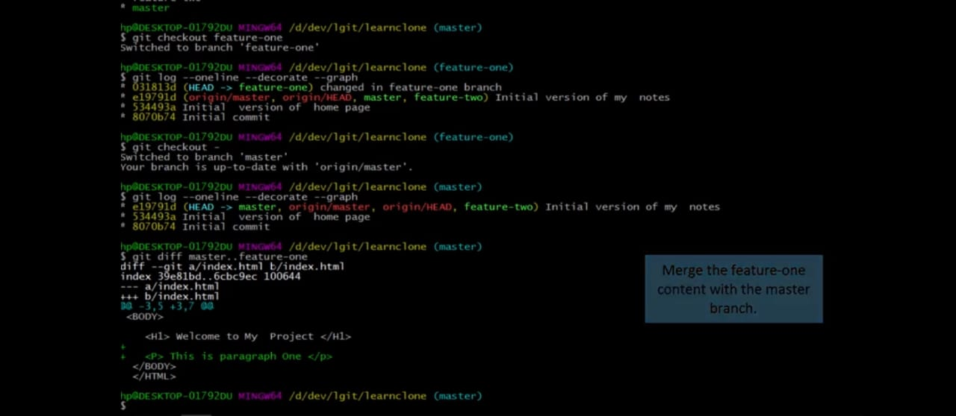
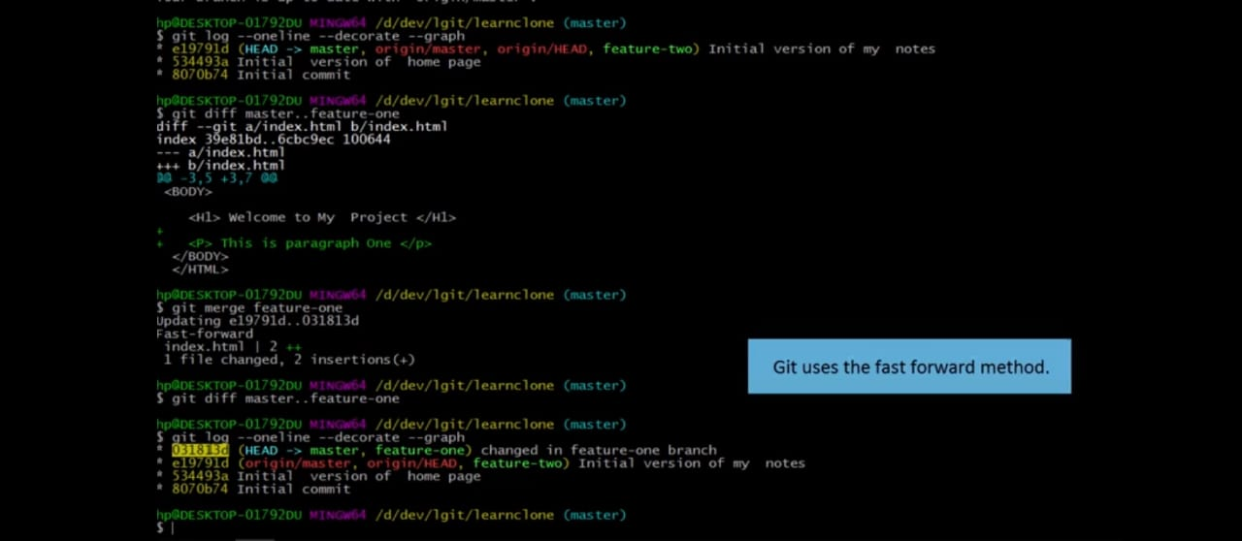
4
Final output like :
5

Slide 50
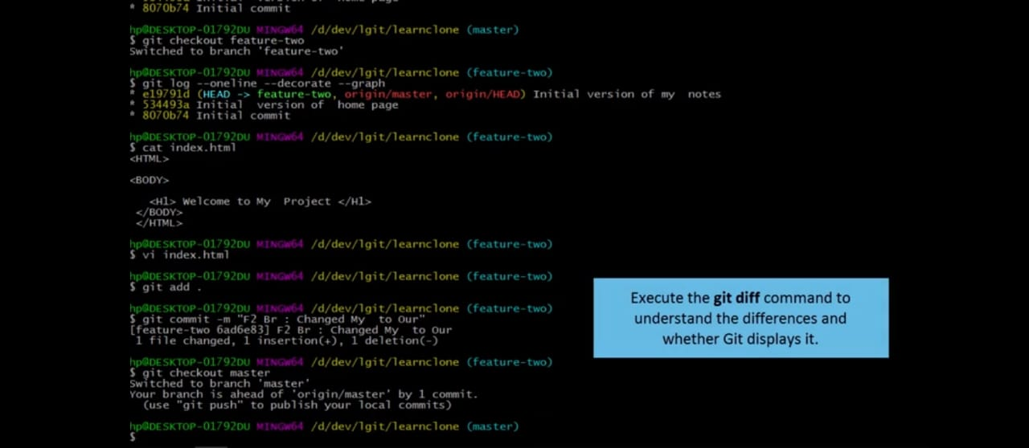
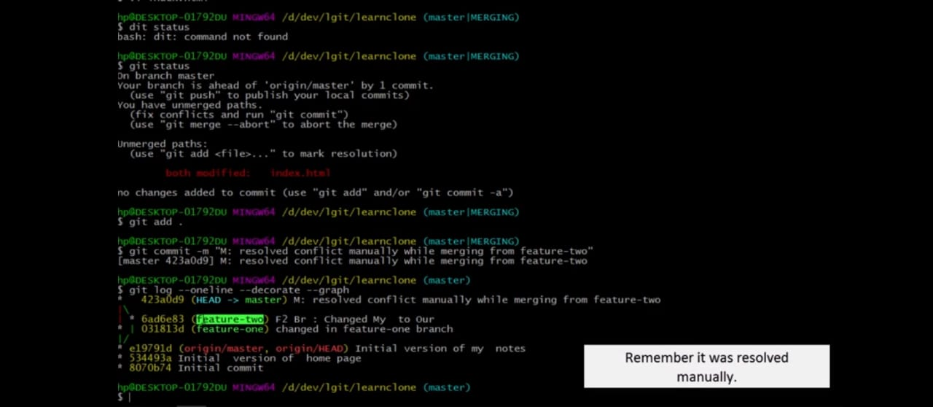
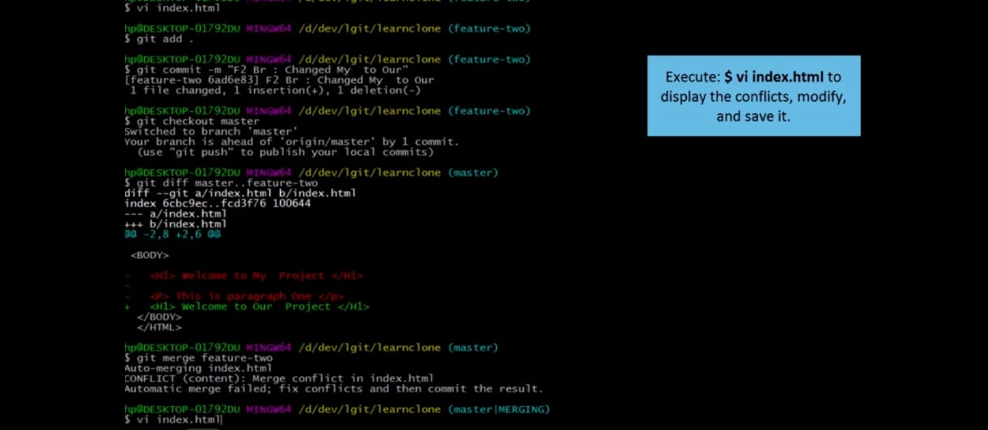
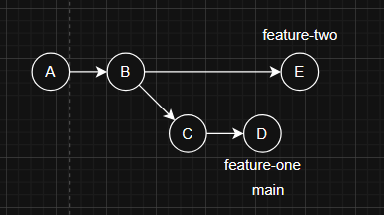
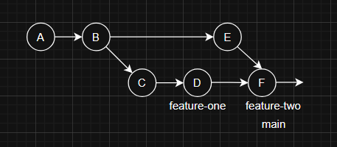
Demo 2 : creating of new feature-two branch and merge into main with raised conflict and resolve of these.
Note : due to conflict, new commit F will create after resolve.
6
8
Final output like :
7

Slide 51
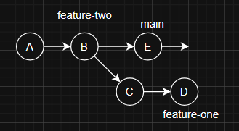
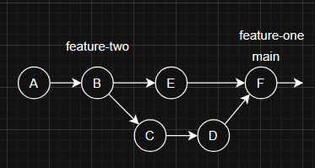
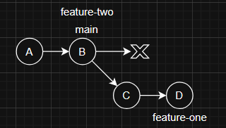
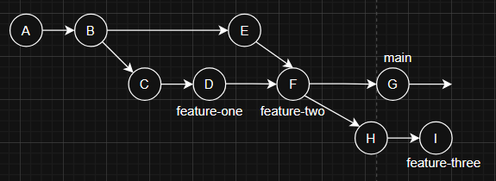
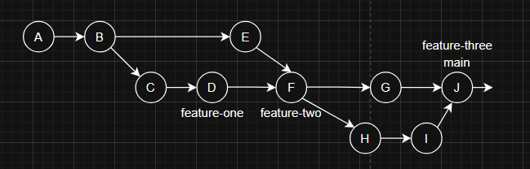
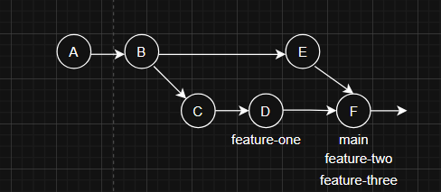
Recursive Merge : Recursive merge is default merge which is deal with multiple merge bases. For that git create merge_base and merge recursively. Here we can check any three top or bottom diagram, Which is use the recursive merge, when feature branch parent commit is not same with main branch latest commit. It will create new commit in recursive merge.
Or

Slide 52
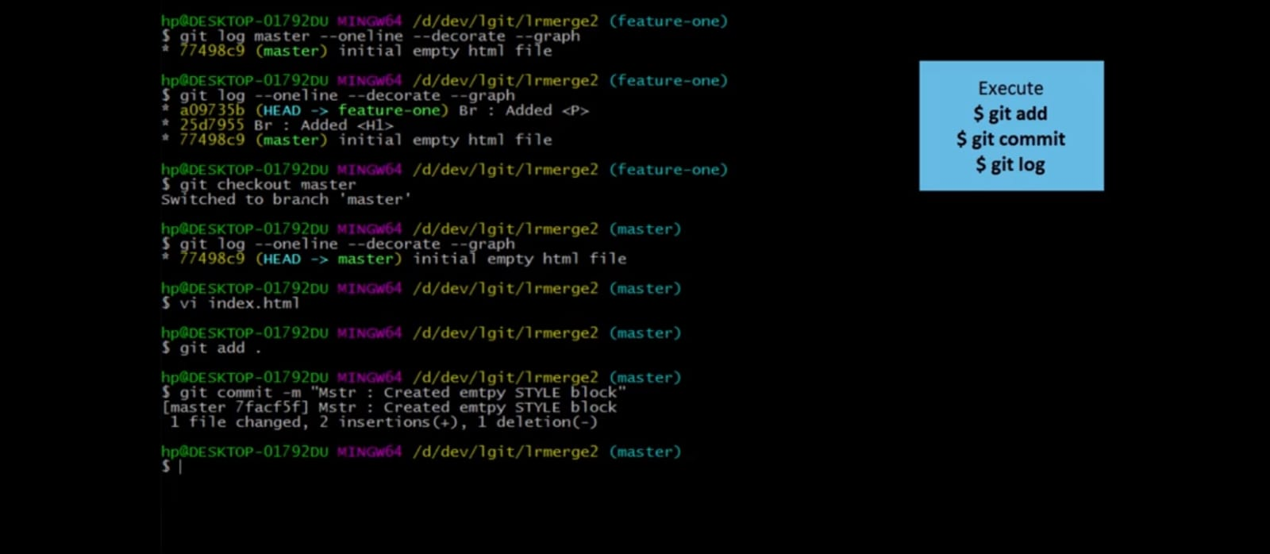
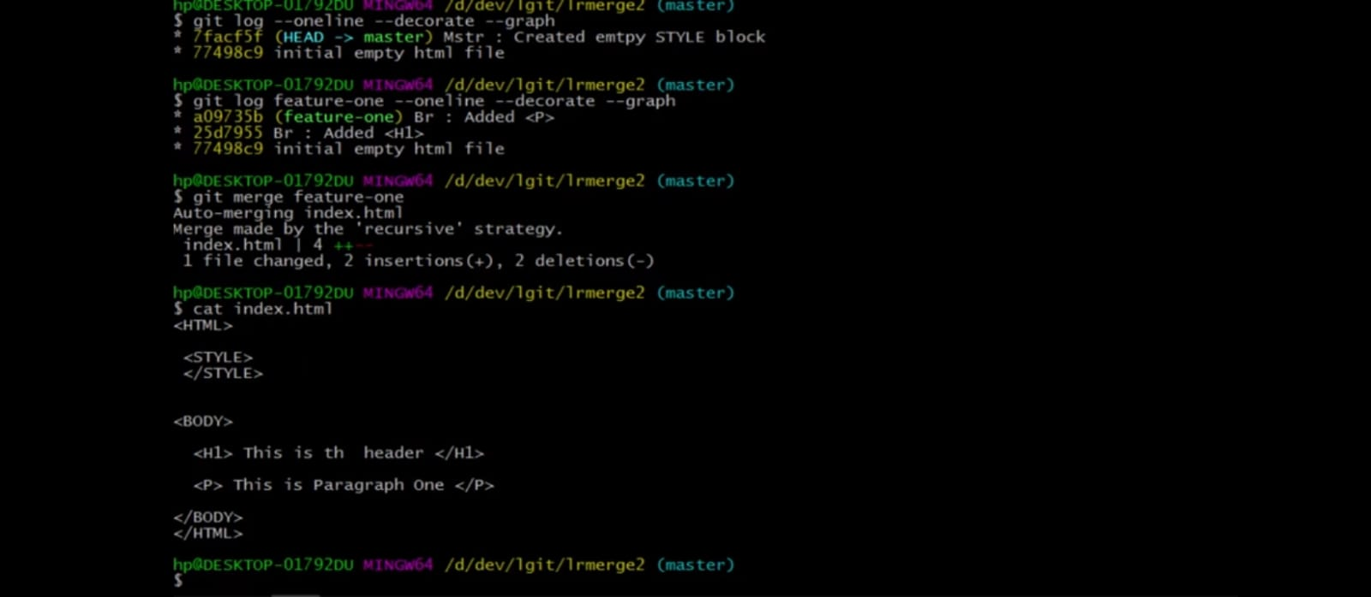
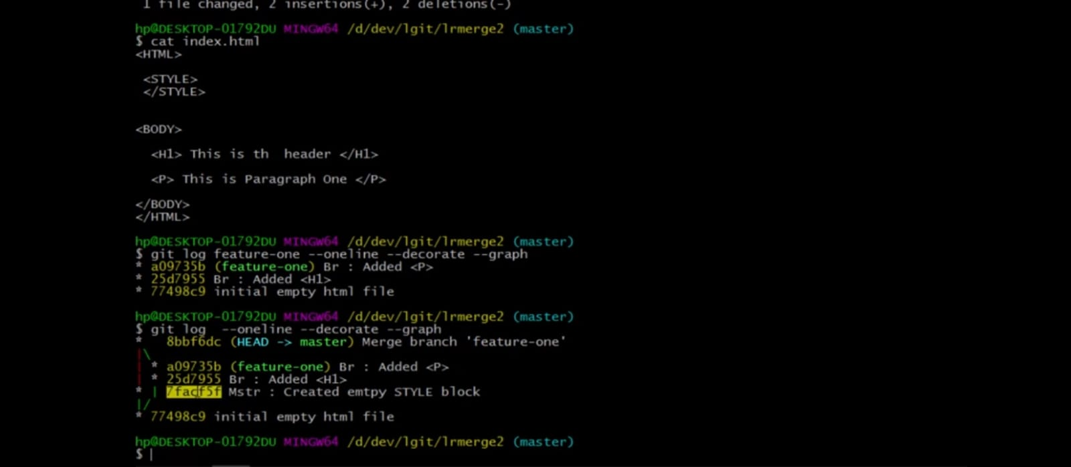
Demo : In this demo will display the merge using recursive merge method as following;
1
2
3

Slide 53

Known About The Git Rebasing : Git rebasing is also use for integrate the change from one Git branch to another which combines two or more sequence commits changes and merge into target branch by rewriting/moving all those changes commit onto the latest commit of target branch.
But before the rebasing, we should analyse the difference Between two branches using `git diff` command or using Gui ( graphical user interface ) tool.
rebase Commands - git rebase command use to refer the process of moving branch commits to a different commit on another branch. . But it should not be use on public repository.
$ git rebase <source_branch_name>

Slide 54





Rebase workflow diagram : these diagram show the rebase workflow;
Before rebasing -
After rebasing -
Or

Slide 55



Demo : these demo display the rebasing on git;
1
3
2

Slide 56

Difference between merge and rebase :

Slide 57

Known About The Git Stash : Git stash records the current state of working directory and the staging area then can also revert to a clean working directory. It’s useful when we want to revert the last commit for some purpose or for moving on another branch, but current working directory have some changes.
stash Commands - There are many commands for git stashing which are used for save/ take the snapshot of change, apply the changes on any branch, list the snapshot, show difference or clear etc.
$ git stash | git stash save ”message” | git stash push ”message” # Use for take the snapshot of changes…
$ git stash apply # Use for applied changes on working dir but don’t remove snapshot… $ git stash pop <stash@{index}> # Use for applied stash changes on directory and deleted from stash list … $ git stash list # Use for list all the snapshot … $ git stash show <stash@{index}> # Show the summary of changes in latest stash snapshot … $ git stash drop <stash@{index}> # Delete the specific stash from the list … $ git stash clear # Remove all the stash from list… $ git stash create | git stash store # Use for others operations…

Slide 58



Demo : Display the git stash demo using git.
2
1
3

Slide 59


4
5

Slide 60

Known About The Git Clone : Git cloning helps in creating a copy of the repository and links it to the original repository, to facilitate working collaboratively. This cloning are the combination of copy the working directory and clone the original repository. So here clone takes two argument, first is <URL of the original repo> and second is <destination dir>
clone Commands - It command use to take the clone.
$ git clone <original_repo_dir> <destination_dir> Or
$ git clone <original_repo_URL> <destination_dir>

Slide 61



Demo : This display the process for taking the clone, by using repo_directory and repo_URL.
Using repo_directory :
1
2
3

Slide 62


Using repo_URL :
1
2

Slide 63


Slide 64
End

